Slide 1
Analysis and Prediction Of Breast Cancer Using Machine Learning Techniques

Slide 2
Team Members
19BAI10013 Rahul Raj Pandey
19BAI10105 Rahul Bhardwaj
19BAI10119 Sidhya Virya Singh
19BAI10121 Siddhartha S. Mukherjee
Project Guide
100215 Dr. L Shakeera
Senior Assistant Professor, SCSE

Slide 3


INTRODUCTION

Slide 4

INTRODUCTION
The early diagnosis of Breast cancer can improve the prognosis and chance of survival significantly, as it can promote timely clinical treatment to patients.
Further accurate classification of benign tumors can prevent patients undergoing unnecessary treatments.
Breast cancer (BC) is one of the most common cancers among women worldwide.
Cancer-related deaths according to global statistics, making it a significant public health problem in today’s society.

Slide 5
Existing Work With Limitations
One of the common method is of Breast Cancer detection is Mammography.
A mammogram is an x-ray picture of the breast. It can also be used if you have a lump or other sign of breast cancer.
Screening mammography is the type of mammogram that checks you when you have no symptoms.
It can help reduce the number of deaths from breast cancer among women ages 40 to 70.
Mammograms are also recommended for younger women who have symptoms of breast cancer or who have a high risk of the disease.

Slide 6
LIMITATIONS
Mammograms do not detect all cancers -
Some cancers cannot be detected on a mammogram due to the location of the cancer or the density of the breast tissue.
About 25 per cent of cancers in women ages 40-49 are not detectable by a screening mammogram, compared with about 10 per cent in women older than 50.
Does not classify cancer type –
A tumor can be benign (not dangerous to health) or malignant (has the potential to be dangerous).
Benign tumors are not considered cancerous: their cells are close to normal in appearance, they grow slowly, and they do not invade nearby tissues or spread to other parts of the body.
Malignant tumors are cancerous. Left unchecked, malignant cells eventually can spread beyond the original tumor to other parts of the body.
The term “breast cancer” refers to a malignant tumor that has developed from cells in the breast.

Slide 7
Proposed Work and Methodology
We will be making a Machine Learning model which will be using a dataset to classify the breast cancer into two types
1.) Malignant 2.) Benign
We will be using advance classification and optimization methods for increasing the accuracy of our predicting model
Our model will be able to classify the cancer in to the above given types with high accuracy on the set of data given by the client
Block diagram of our methodology-
Dataset
Pre-processing data
Building Model
Training
Testing
Result

Slide 8
Novelty Of The Project
Novelty of this project is applying ML algorithms in individual breast cancer risk prediction and comparing predictive accuracy with existing models.
We will demonstrated a range of ML algorithms with cross-validations, which is lacking in other applications of ML for cancer .
Ranking variable importance may inform algorithm selection with diverse predictive risk factors for future development of new risk prediction models.

Slide 9
Real Time Usage
The last two decades a variety of different ML techniques and feature selection algorithms have been widely applied to disease prognosis and predictions.
This model provided that it gets accurate data can be used in clinical practice as a medical tool
This model will help in reducing the human efforts which will help doctors to take proper decisions and steps on time resulting in the benefit of patient and overall society.

Slide 10
Hardware & Software Requirements
Hardware Requirements –
PC with following specifications :-
Memory: 16 GB DDR4-3200
GPU : Nvidia GTX 1080 (4 GB VRAM)
Processor: Intel Core i5-9300H

Slide 11
Hardware & Software Requirements
Software Requirements
Virtual Studio Code
Jupyter Labs
PyCharm
MS Excel

Slide 12
Hardware & Software Requirements
Tools Required :-
Anaconda (version.4.7.12)
Python 3.6 (or any version of Python 3)
Scikit-learn (version 1.1.0)
Pandas (version 0.24.1)
Numpy (version 1.15.4)
TensorFlow (version 1.15)

Slide 13
System Architecture Diagram
Our Project’s
Dataset
Data
Pre-processing
Implementing various M.L techniques **
Patient New Data
Cleaning
Transforming
Prediction of cancer
Feature Selection
Generating Report
Test Data
Train Data
** ML Techniques – Logistic Regression, Decision Tree, Random forest, K-nearest Algorithm, SVM.

Slide 14
Reference Papers
https://www.arxiv-vanity.com/papers/1711.07831/
https://www.ijecs.in/index.php/ijecs/article/download/4071/3827/
https://www.researchgate.net/publication/319688741_Breast_Cancer_Prediction_Using_Data_Mining_Method
https://www.sciencedirect.com/science/article/pii/S2405959520300801

Slide 15
Literature Review
The project by S. Gokhale, is using the ultrasonography(USG) technique which is a powerful method in detecting details about the breast mass that usually cannot be detected even by mammography.
A project by Abien Fred M. Agarap uses different methods like GRU-SVM, NN, multilayer perceptron (MLP), SoftMax regression to classify the dataset into benign or malignant.
A project by Priyanka Gupta shows the comparison of the lesser invasive techniques such as Classification and Regression Trees (CART), random forest, k nearest neighbor and boosted trees. These four classification models are chosen to extract the most accurate model for predicting cancer survivability rate.
A project by Yixuan Li and Zixuan Chen shows a performance evaluation using three indicators including prediction accuracy values, F-measure metric and AUC values are used to compare the performance of the classification models.

Slide 16
Module Description
Data Collection -
Data collection is the process of gathering and measuring information on variables of interest, in an established systematic fashion that enables one to answer stated research questions, test hypotheses, and evaluate outcomes
Data Wrangling –
Data wrangling is the process of cleaning and unifying messy and complex data sets for easy access and analysis
Data Normalization-
Data normalization is a process in which data attributes within a data model are organized to increase the cohesion of entity types. The goal of data normalization is to reduce and even eliminate data redundancy.

Slide 17
Module Description
4. Data Visualization-
Data visualization is the act of taking information (data) and placing it into a visual context, such as a map or graph to provide an accessible way to see and understand trends, outliers, and patterns in data.
5. Feature Selection-
Feature Selection is the process where you automatically or manually select those features which contribute most to your prediction variable or output in which you are interested in
6. Model Building –
Model building is the process of developing a probabilistic model that best describes the relationship between the dependent and independent variables
7. Deployment –
The concept of deployment in data science refers to the application of a model for prediction using a new data.

Slide 18

Module Workflow
Data Collection
Accurate data collection is essential to ensure the integrity of the research, regardless of the field of study or data preference.
The goal for all data collection is to capture quality evidence that allows analysis to lead to the formulation of convincing and credible answers to the questions that have been posed.
In our project is we are using WISCONSIN (Diagnostic) Data Set for Breast Cancer provided by UCI Machine Learning Repository.

Slide 19
Module Workflow
Data Wrangling -
Data wrangling refers to the process of cleaning, restructuring and enriching the raw data available into a more usable format.
This will help the scientist quicken the process of decision making, and thus get better insights in less time.
The data is cleaned thoroughly for high-quality analysis. Null values will have to be changed, and the formatting will be standardized in order to make the data of higher quality.
In our project we find out the number of null values and columns having null values, these null value are either removed or changed with the mean/ median / mode of the column they belong.
We changed the representation of Malignant and Benign to 0 and 1 to ease our further process.

Slide 20
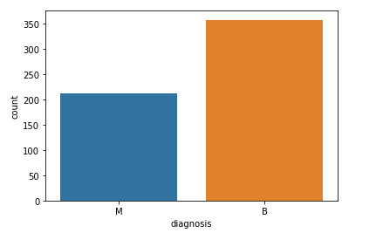
Implementation And Coding
We first try to Visualize our attributes to get insights on our datasets and which attribute will affect the predictions.
To do this we will plot various graphs regarding correlations of attributes .
Then we will divide our dataset in testing and training set for training and testing of model

Slide 21
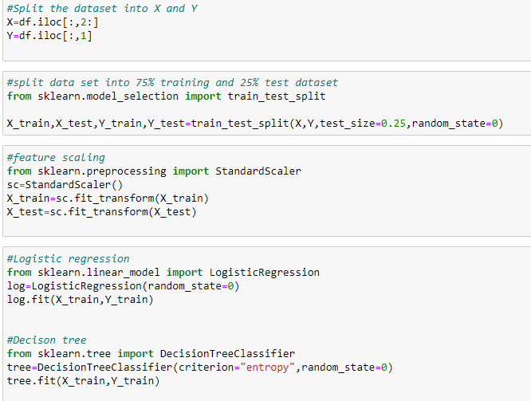
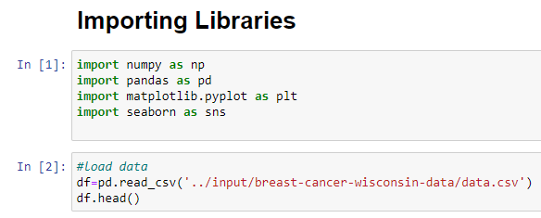

Coding
Using required python modules like pandas , numpy for making data frame from dataset and using matplotlib and seaborn for Visualization and sklearn for model building.

Slide 22
SNAPSHOTS
of Our Project

Slide 23

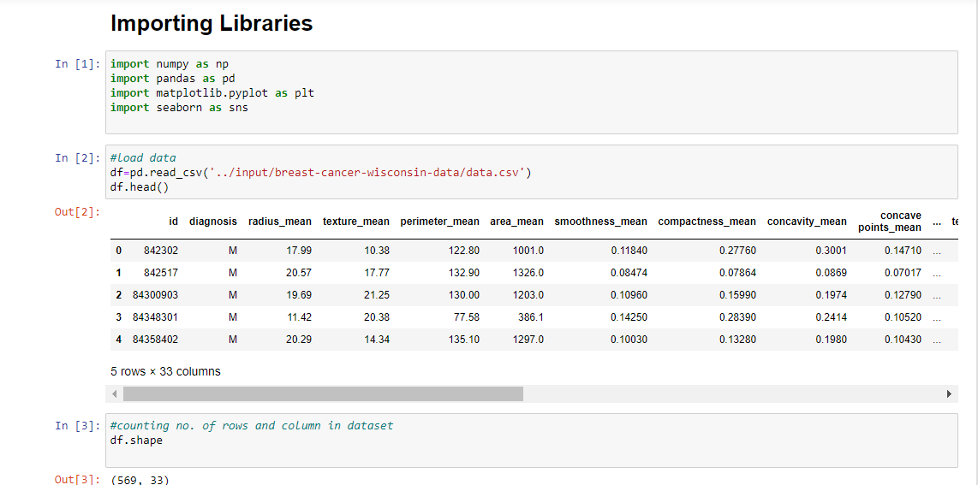
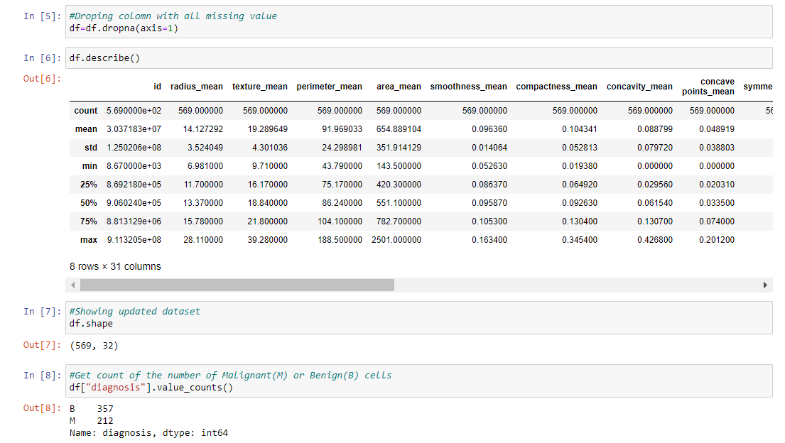

Slide 24
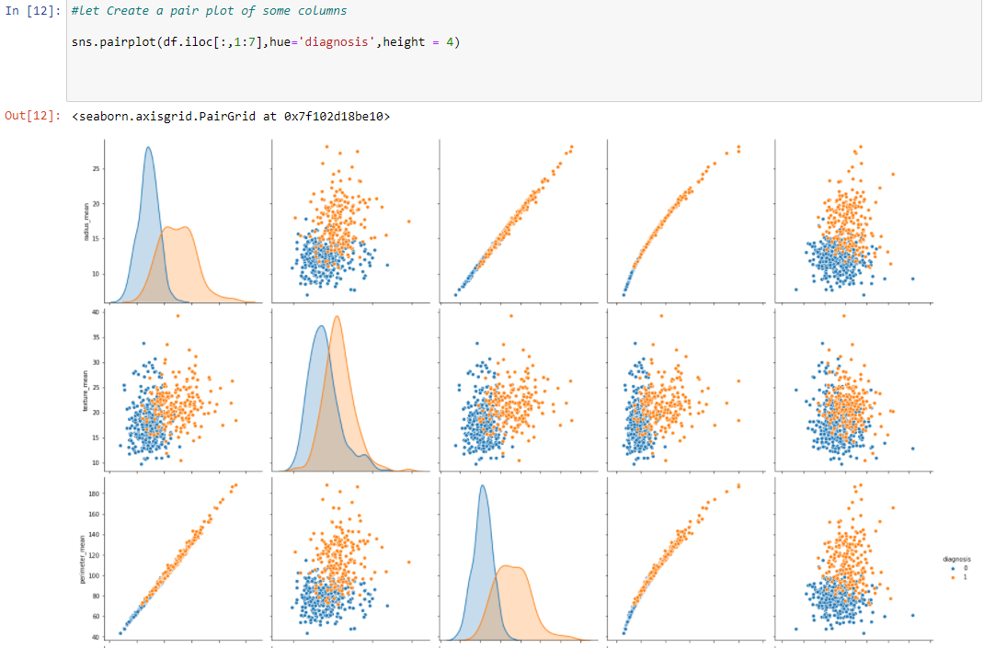

Slide 25



